Slide 1
Lesson 7: السادس الدرس Welcome to Arabic Level I by Kurzban Objectives: Review Arabic Numerals ( 1-10) Practice Summary Flash card

Slide 2
Numerals Review!
واحد إثنان ثلاثة أربعة
____ ____ ____ ___
خمسة ستة سبعة ثمانية
___ ___ ____ ____
تسعة عشرة
___ ____

Slide 3
Numerals
The system of numeration employed throughout the greater part of the world today was probably developed in India, but because it was the Arabs who transmitted this system to the West the numerals it uses have come to be called Arabic.
Reference: http://www.islamicity.com/mosque/ihame/Ref6.htm

Slide 4
Let’s start
أربعة / ستة/عشرة
إثنان / سبعة / خمسة
واحد / ثمانية /تسعة
ثلاثة

Slide 5
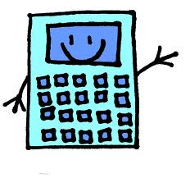
Let’s do some Math!
Write your responses in Arabic!
1] 2+ 5 = _______ ____________________
2] 8 – 4 = _______ ____________________
3] 10 – 5 = _______ ____________________
4] 7 + 2 = _______ ____________________
5] 10 – 7 = _______ ____________________
6] 2 + 6 = _______ ____________________
7] 9 – 8 = _______ ____________________
8] 2 + 8 = _______ ____________________
9] 4 + 2 = _______ ____________________
10] 6 – 4 = _______ ____________________

Slide 6
Lesson 7: Introduction to pronouns
أنا
انت
انت
هو
هي

Slide 7
Lesson 7: Vocabulary Look back at your notes and provide a definition for each
Try to add short vowels above the letters
السلام عليكم
اسمي
الى اللقاء /مع السلامة
انا

Slide 8
Lesson 6: Numbers السادس الدرس
A little background on Arabic numerals
Please read the article under the link below
http://www.unc.edu/~rowlett/units/roman.html

Slide 9
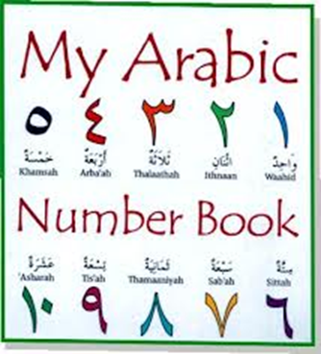
Summary
Take this quiz on line:
http://quizlet.com/2470196/test/

Slide 10
Feminine words
You have already seen that there are two genders in Arabic. All nouns ( people, objects, ideas, etc) are either masculine or feminine.
Luckily it is fairly easy to tell which gender a particular word is.
There is a special feminine ending that is a “ bundled up” [Ta], it’s called ta marbuta ( literally tied up ta) & it is not usually pronounced

Slide 11
Feminine words
There are two main categories of words which are feminine:
Female people or words that refer to females
Singular words that end in ta marbuta.
However, there are few exception this rule.
In general, you can presume a word is masculine unless it falls into on of the two categories above. More details on this topic later on….

Slide 12
Review
1) وَ+ا+بِ+دْ=
2) ا+ثْ+نَ+ا+نْ=
3) زَ+تَ+ا+بِ=

Slide 13
4) دُ+و+ر+ا= 5) نَ+ا+ر= 6) ثِ+ي+بْ+ز=

